Slide 1
BV
零售Retailing
=
每周收入
Weekly income

Slide 2
透过零售建立您的事业
Retailing Builds Your Business
利润 Profit
赚回创业成本
Replaces start up expenses
抵付每月经常开销
Covers monthly overhead expenses
创造现金流
Creates ongoing Business
创造源源不断的业绩点数
Generals ongoing Business Volume
发掘潜在的事业人选
Identifies potential business prospects
建立信心
Builds belief

Slide 3
零售的目标
Objectives of Retailing
建立您的购物年金
Create your own Shopping Annuity
发展10-15人的「忠实顾客基础」，每位顾客每月购买30 BV/20 IBV以上的产品。
Develop 10-15 repeated customers who purchase > 30BV/20IBV monthly
建立顾客占有率
Building share of customer
零售转移到招募
Retail to recruit

Slide 4
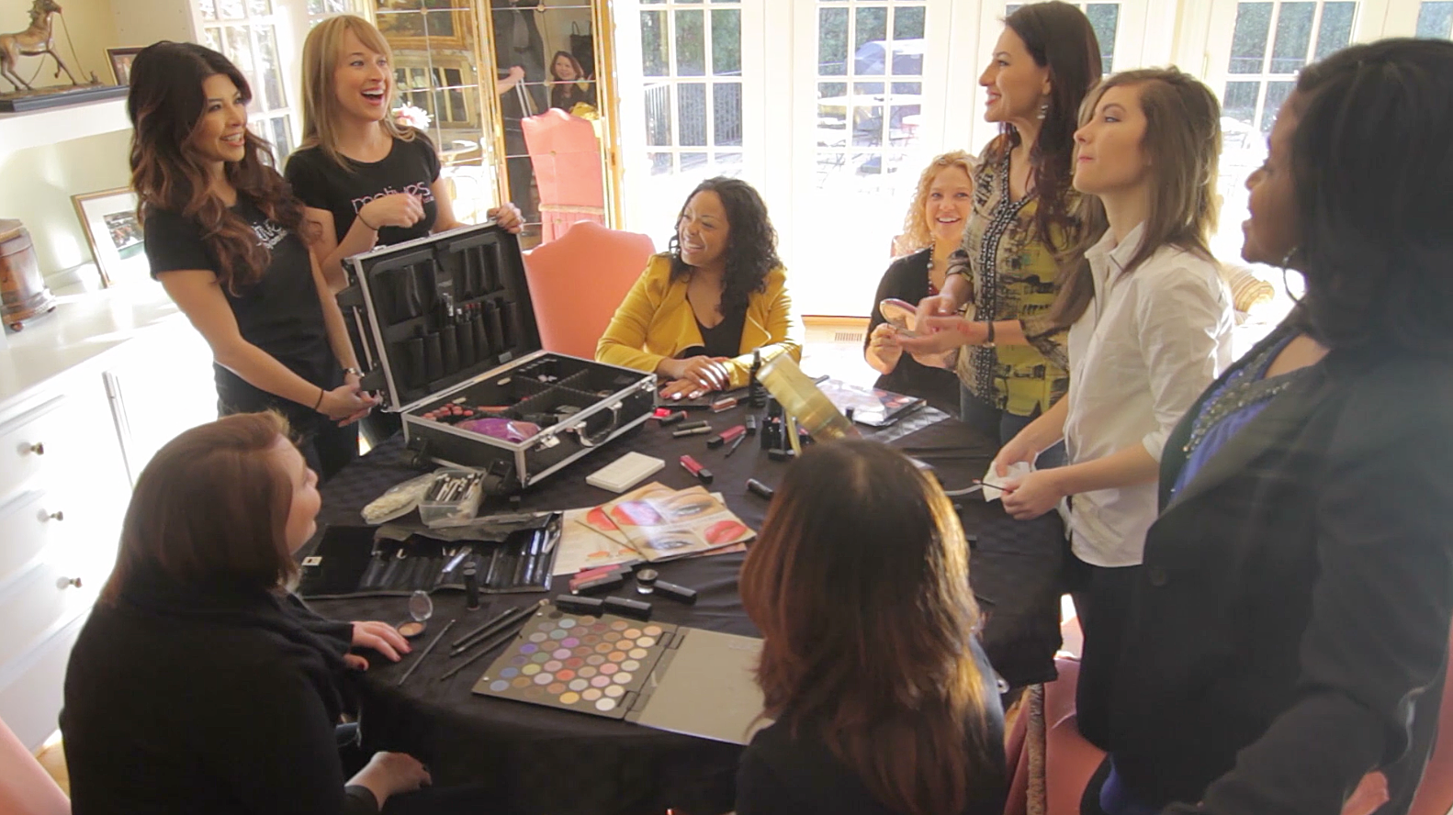
投入零售事业的准备
Preparing to Retail
选择专攻的产品系列
Choose a product line to specialise in
您所用的美安马来西亚产品全部清单
Complete list of products you use
利用居家购物清单
Utilise Home Shopping List
购买合用的销售辅助资料
Purchase applicable sales aids
使用美安马拉西亚产品目录
Use Market Malaysia® Product Catalogue
从MYS.SHOP.COM 网站的伙伴商店中，找到您经常亲临购物或在线购物的商店
Identify all partner stores on your MYS.SHOP.COM site that you are currently purchasing from their physical location or online
参加产品培训和研讨会
Attend product trainings and seminars

Slide 5
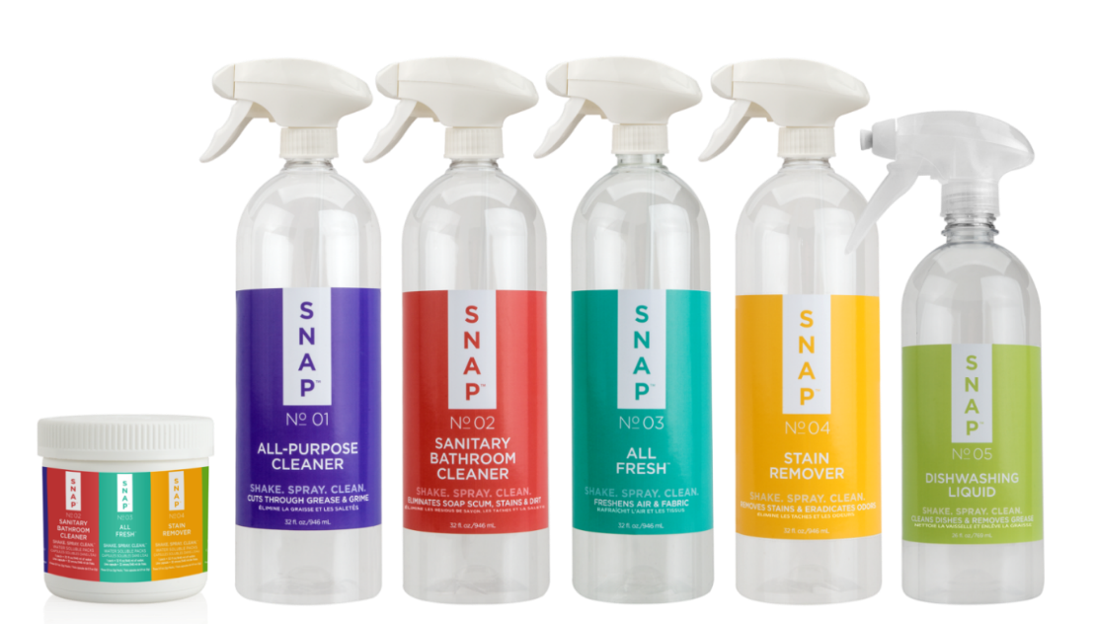
独家代理品牌
Exclusive brands
更优质产品
Better product
更优惠价格
Better prices
给顾客现金回馈
Shop points for customers
现在就开始找出那些您可以在美安马来西亚购买的产品，并停止购买其他品牌，如此才是真正落实购物年金
Start identifying which of the company’s exclusive brands you could use instead of other brands to fund your
Shopping Annuity™
Notes:
TRAINERS NOTES:
Best of all, we aren’t asking you to sacrifice quality or price. Our exclusive brands are superior products, with better prices than the competition and we pay you Cashback for purchasing them.
Not to mention, by choosing these superior products, you are funding your Shopping Annuity

Slide 6
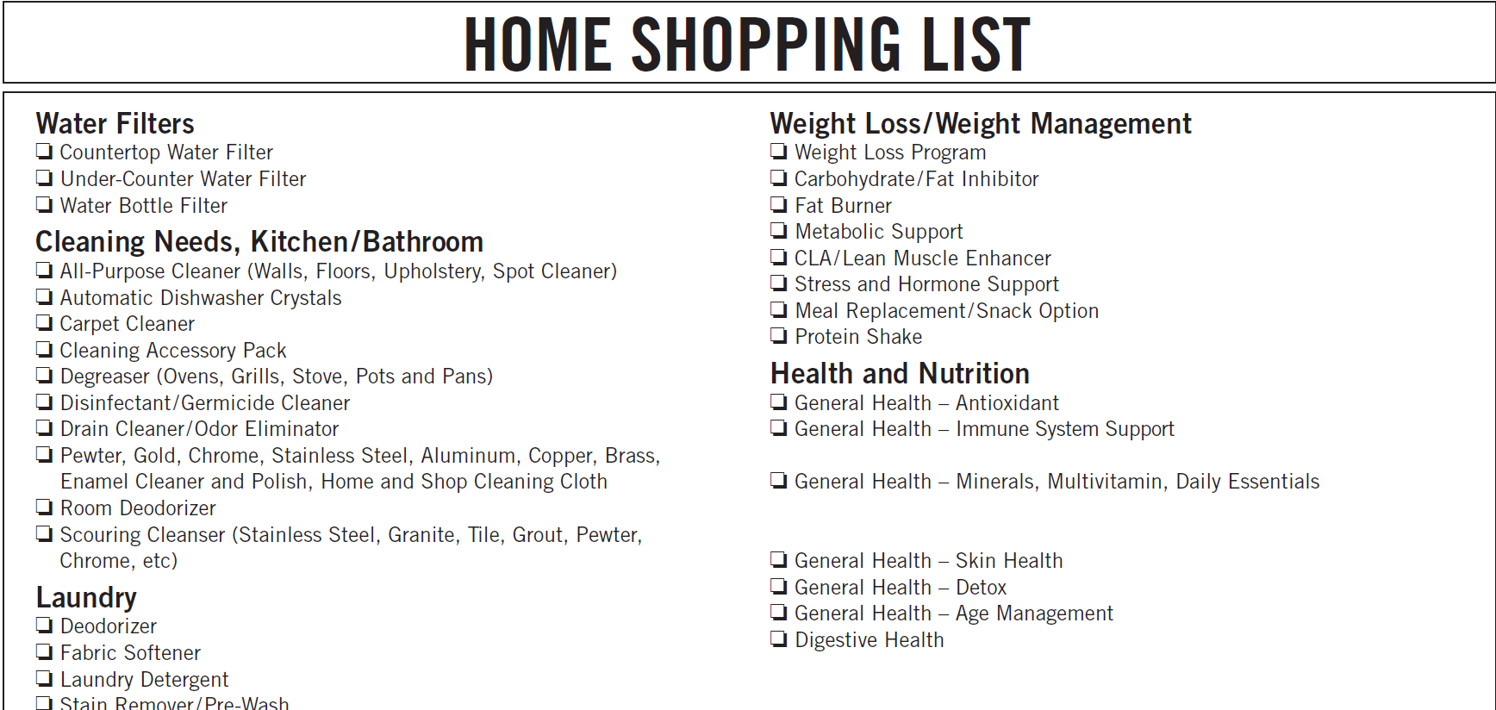
产品代码MY671CHN
每包20份

Slide 7
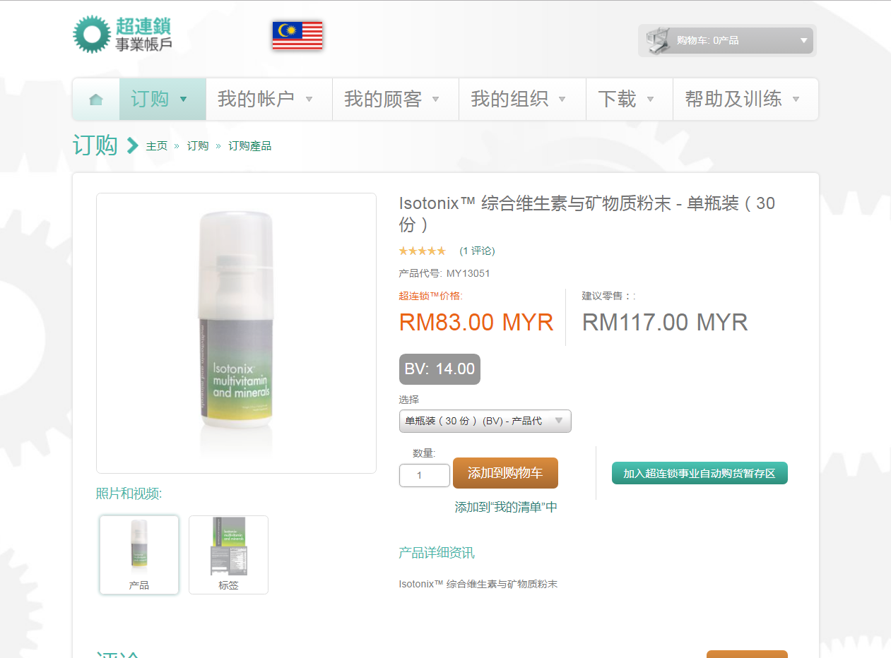
产品辅销资料
Product Brochures
超连锁™事业账户
UnFranchise® Business Account

Slide 8
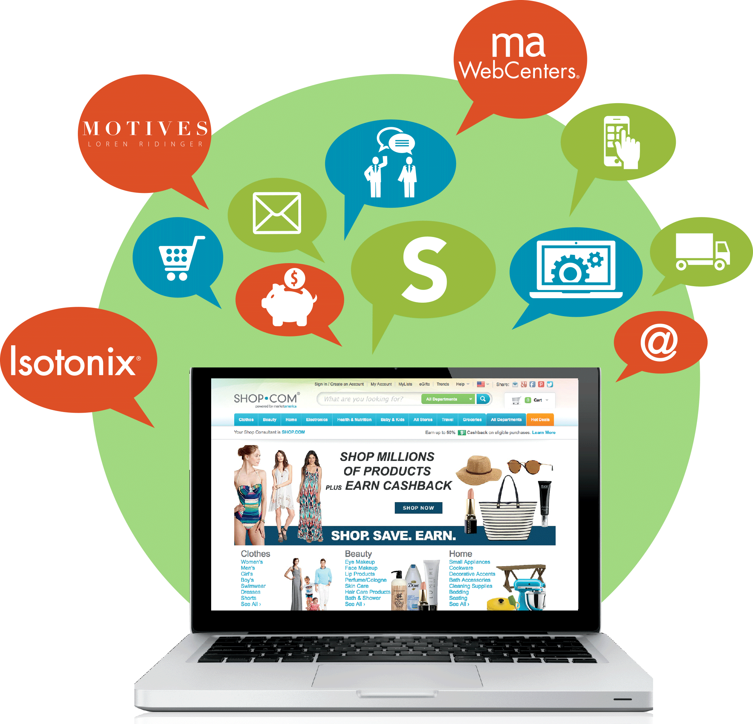
零售成功关键
Keys of Retailing
使用超连锁™事业自动购货，转移您的购物习惯；把自己当作产品的代言人
Transfer your buying habits with UnFranchise® AutoShip. Be a product of the product (you will sell what you use)
为每一产品系列拟定潜在顾客的可能名单（背景资料）；为产品找到合适的顾客，为顾客找到合适的产品
Develop a possibility list for potential customers for each product line (background info). Matching products to people and people to products
描述自己的亲身体验（这有助售卖产品）
Tell your story (stories sell product)
收集并利用见证资料 Collect and use testimonials
获取及提供与产品配套的辅助资料
Obtain and provide literature

Slide 9
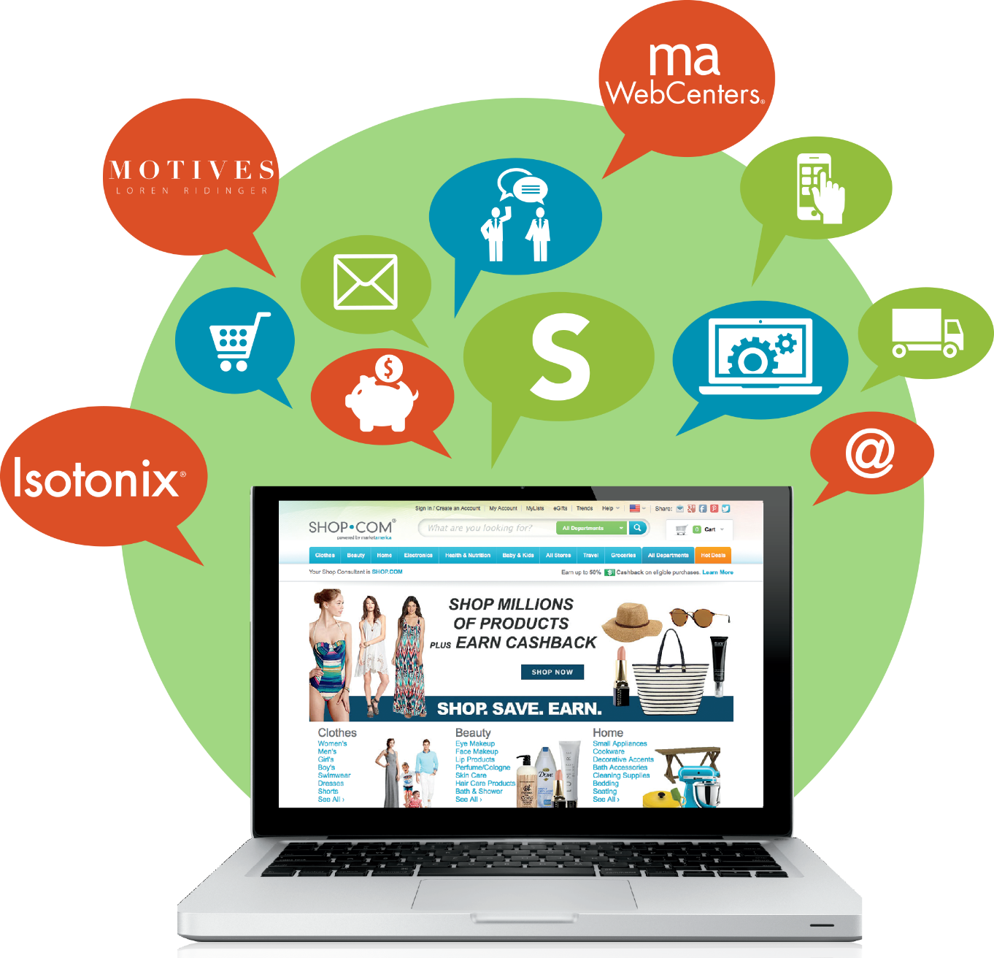
零售成功关键
Keys of Retailing
建立关系 Build relationships
人们厌恶强行推销，但乐意主动购买
People hate to be sold but love to buy
了解您的产品 Obtain knowledge about your product
培训、影片、超连锁™ MeetOn、 超连锁™事业账户、MYS.SHOP.COM及美安马拉西亚大学主修概念
Training, videos, UnFranchise® MeetOn, UnFranchise® account, MYS.SHOP.COM.
执行跟进 Implement a follow up system
增加顾客的购物种类 Build share of customer
建立永续回头客 Build Lifetime customer value

Slide 10
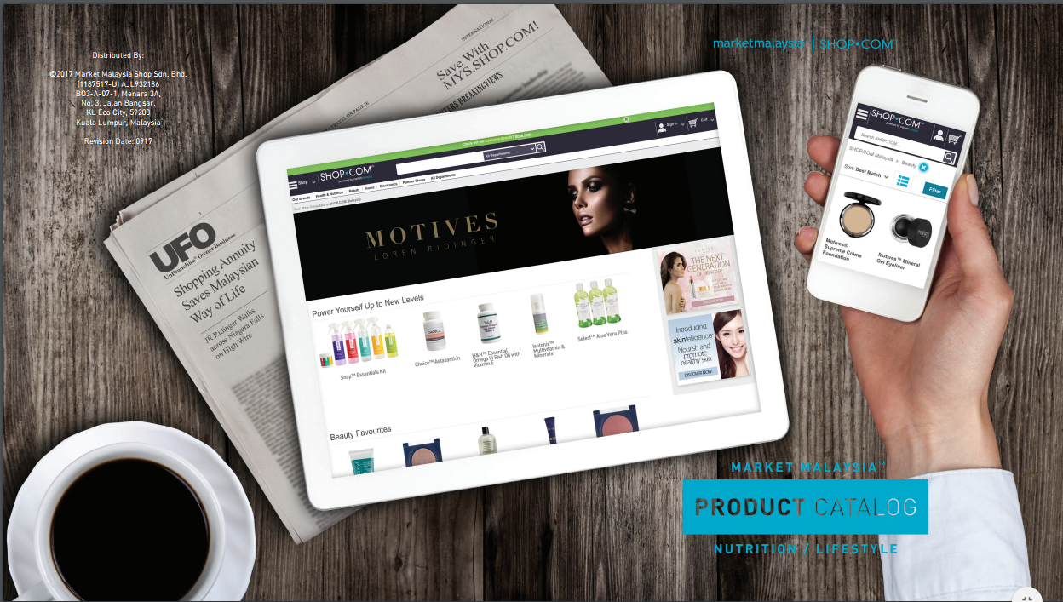
美安马来西亚产品目录
Market MALAYSIA™ Product Catalogue

Slide 11
新人快速启动组合
Fast Start Program
每项新人快速启动组合包含RM100的入会费、RM400的年度入会费、 300 BV的产品，并且免运费（东马除外）。
Each kit includes RM100 Joining Fee, RM400 Subscription Fee, 300BV and free shipping

Slide 12
关系营销
Relationship Marketing
Listen
Share
Recommend
推荐产品和服务
发送产品连结或更多信息
Product or service，Send product link or more information
聆听人们的需要 确定需求
For people that have a need
Identify need
分享故事或见证
Story or testimonial

Slide 13
这是什么 What’s that
将产品放在您触手可及的地方
Have your products out and visible
当别人问时，分享故事
When people ask, tell the story
有人提出问题或质疑时，您可以提供产品来帮助他
People identify a problem or challenge, you present a solution with a product

Slide 14
家庭事业展示会
HOME PRESENTATIONs
家庭事业展示会为何重要？ Why are they important?
现金流
Cashflow
让您的事业在30天内获得利润
Have your business operating profitable in 30 days
协助新超连锁™店主认识美安马来西亚产品，并介绍产品给朋友、家人及同事
Expand the product knowledge of the new business owner and introduce products to friends, family, associates
增强组织的稳定增长
Increase
stability of an organization

Slide 15
家庭事业展示会
HOME PRESENTATION
选择一个主题 Choose a theme
健康101
Wellness 101
个人保养
Look Good, Feel Good
美妆派对
Beauty Events
TLS™概览
TLS™ overview

Slide 16
家庭事业展示会
HOME PRESENTATION
邀请来宾 Inviting
打电话、发简讯、
发电邮
Call, text, email
询问顾客有哪些有兴趣了解的
事项
Ask what your guests are interested in learning about
告诉顾客出席的演讲者
Edify who the speaker will be
确定来宾人数
Confirm attendance

Slide 17
家庭事业展示会
HOME PRESENTATION
做好准备 Be Ready
样品
（如有需要，则需事先调配）
Samples
(pre-mixed if necessary)
笔记型电脑及接线
(HDMI/ VGA)
Laptop with connecting cable (HDMI)
居家购物清单
（开始时填妥）
Home Shopping List
(fill out at the beginning)
可展示的瓶装产品
Product bottles
physically available
产品样本
（每日精选营养组合包）
Products to sample
销售的产品
Products to sell
产品目录
Product catalogues
一些常用的订购表格 （记事簿）
Some type of order form (note pads)
好玩/愉快的派对气氛
送出的奖品
“Giveaway” door prizes
套装产品或附加产品
Packages or add on products
寻求销售产品及约会跟进
Ask for the sale and
book follow ups

Slide 18
完成交易
Closing the Sale
答覆各类问题
Address and answer any questions
为尚未正式登记的优惠顾客建立档案
Create a Preferred Customer Profile if they are not already registered
接受订单
Place the order

Slide 19
完成交易
Closing the Sale
安排跟进计划 Schedule a follow up
MYS.SHOP.COM 网站导览
MYS.SHOP.COM tour
将MYS.SHOP.COM 设为首页
Set MYS.SHOP.COM as home page
多次销售 Repeat sales
自动送货 AutoShip
销售其他产品
Additional product sales

Slide 20
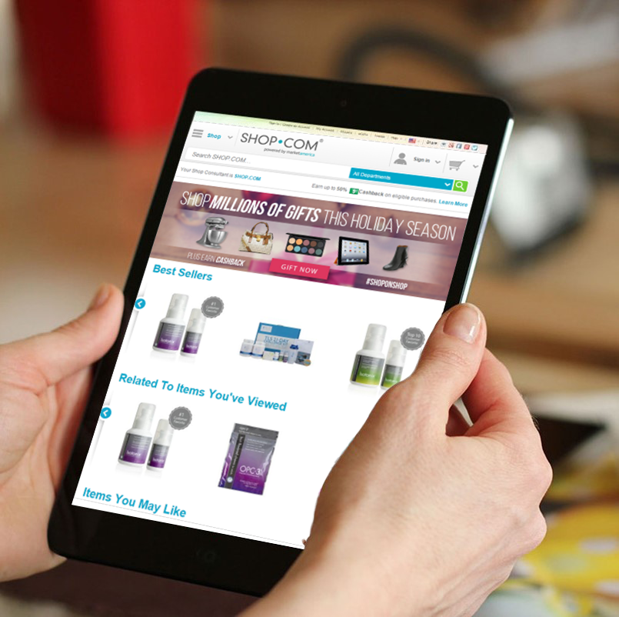
使用您的网站
分享您的网站
了解您的
MYS.SHOP.COM网站

Slide 21
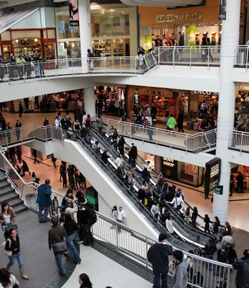
传统实体商店 Brick and Mortar
线上购物
Click and Order
转为
Notes:
TRAINERS NOTES:
You have to be aware of the money you would “leak” in the stores and switch it to SG.SHOP.COM
If you are already an online shopper, you have to shift your spending behaviors to go through SG.SHOP.COM first or simply install and login to ShopBuddy to make sure you are funding your Shopping Annuity.

Slide 22
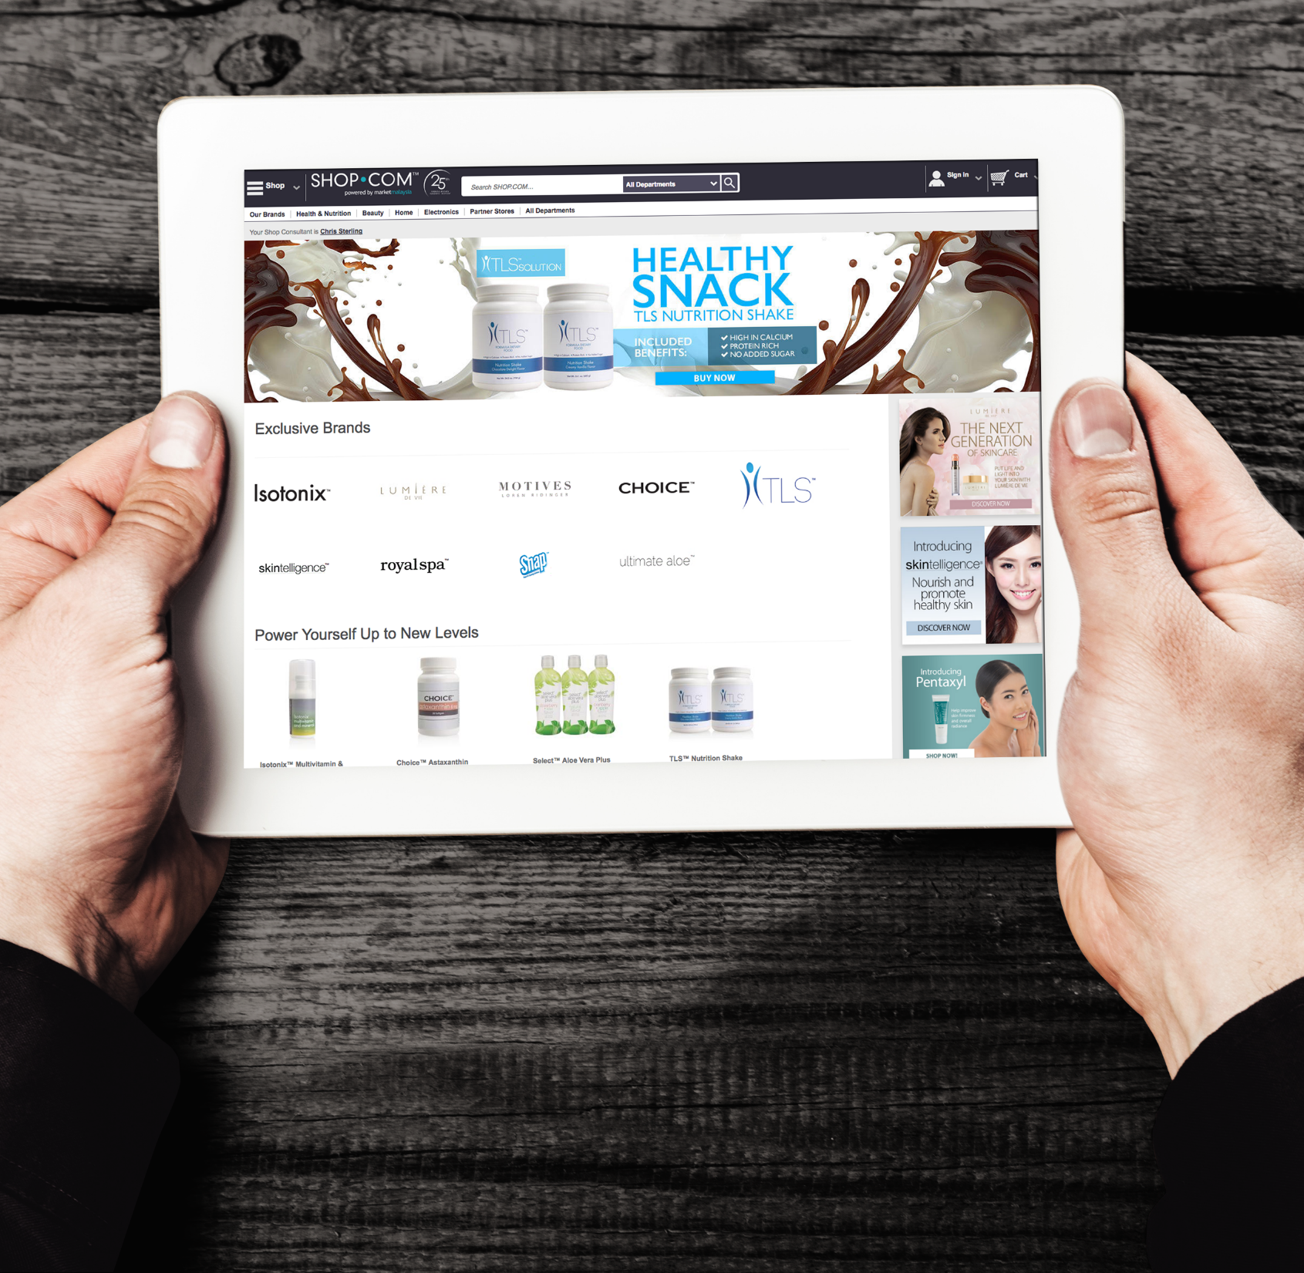
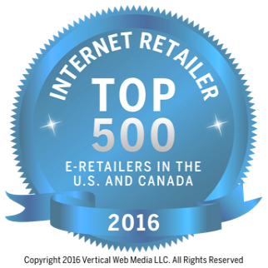
网际网路行销公司
AN INTERNET MARKETING COMPANY
数千家伙伴商店，数百万项产品
THOUSANDS OF PARTNER STORES’ WITH MILLIONS OF PRODUCTS
数百项美安独家产品
HUNDREDS OF EXCLUSIVE PRODUCTS’
无需任何费用即可注册成为优惠顾客
NO COST TO REGISTER AS A PREFERRED CUSTOMER
排名
59

Slide 23
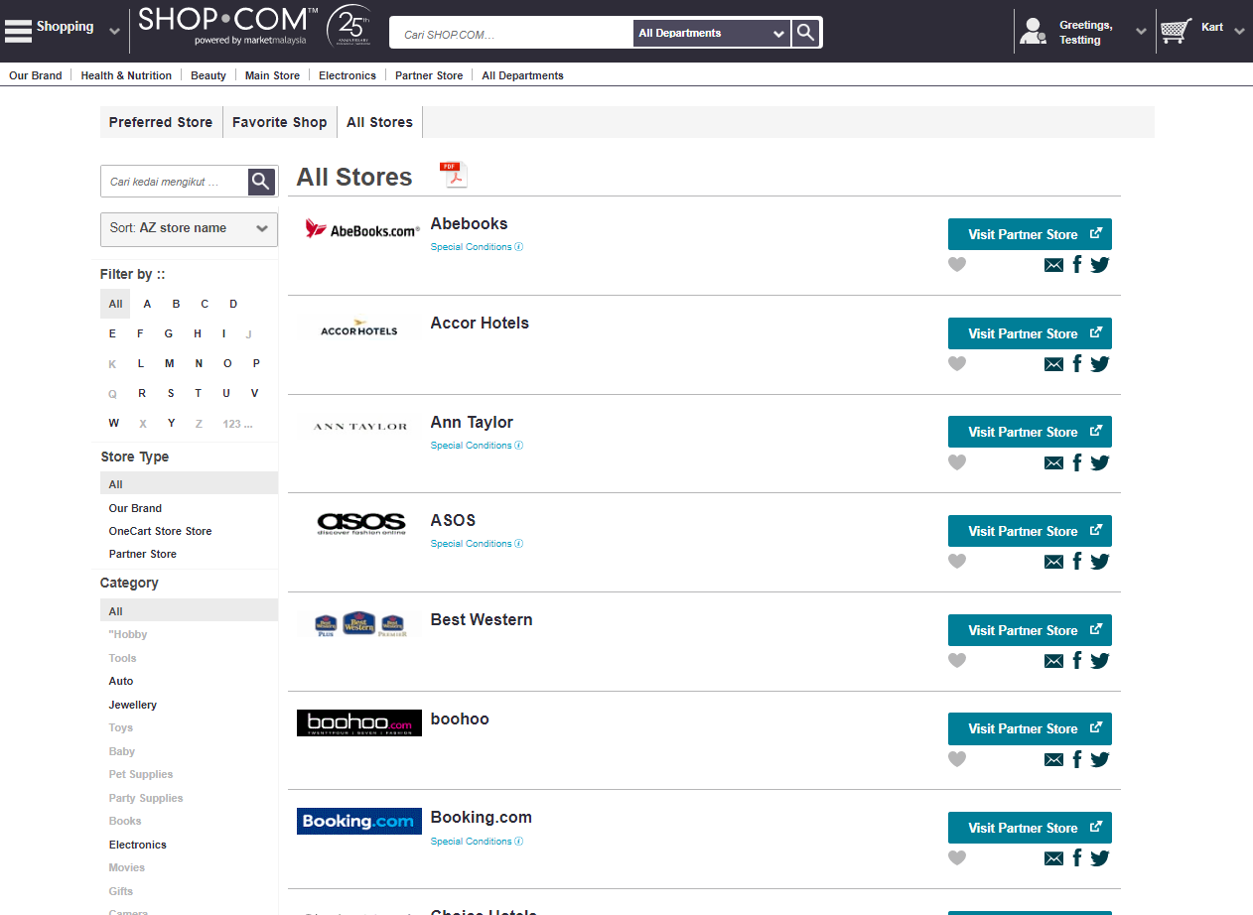
伙伴商店
Partner Store

Slide 24
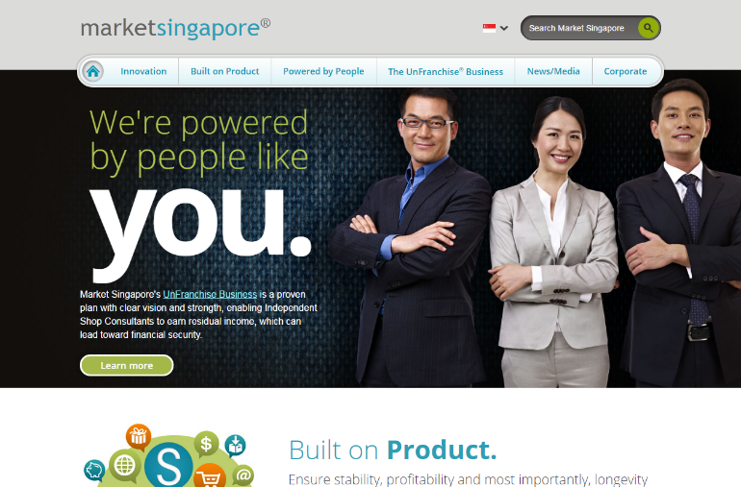
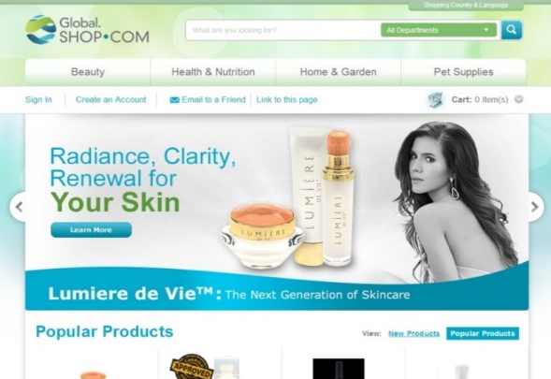
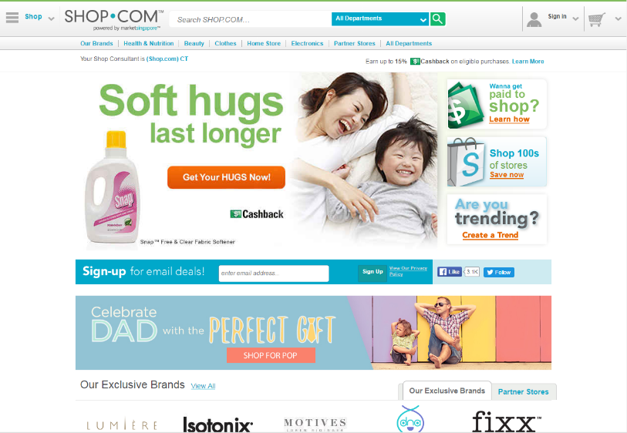
MarketMalaysia.com/您的名称
您可以使用您的您的名称来品牌化您的网站
These sites are branded with your /yoursitename
MYS.MotivesCosmetics.com/您的名称
MYS.SHOP.COM/您的名称
Global.SHOP.COM/您的名称

Slide 25
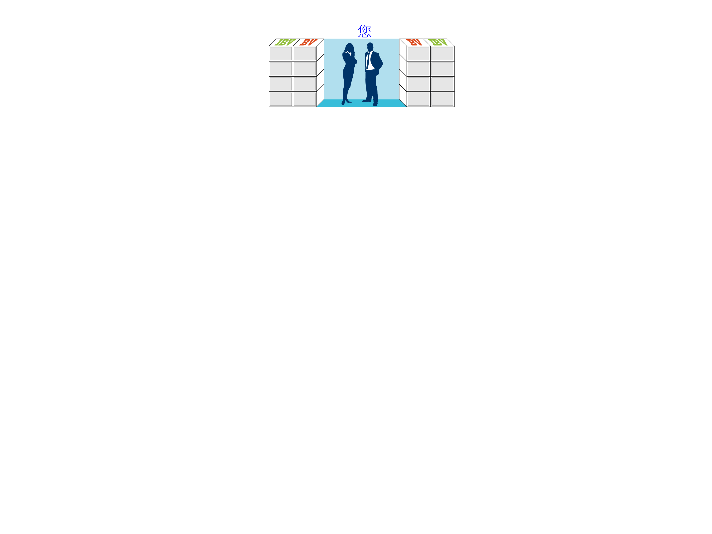
零售目标 Retail Sales Goal
新超连锁™店主的每月目标是本人购买并使用200 BV 和 20 IBV的产品
开发至少十位优惠顾客， 并且鼓励每人每月至少购买 30 BV / 20 IBV 的产品，
从中产生300 BV 和200 IBV
Monthly Goal for new UnFranchise® Owner is to generate 200 BV and 20 IBV from personal use
300 BV and 200 IBV to a base of at least 10 Preferred Customers ordering 30 BV and 20 IBV per month.
优惠顾客
优惠顾客
-
-
-
-
-
-
-
-
-
-
优惠顾客
优惠顾客
优惠顾客
优惠顾客
优惠顾客
优惠顾客
优惠顾客
优惠顾客
优惠顾客 = 30 BV及20 IBV
PC = 30 BV and 20 IBV
超连锁™店主每月总共产生： 500 BV及220 IBV
Total UnFranchise Owner Production: 500 BV and 220 IBV

Slide 26
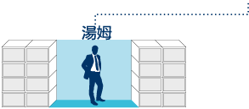
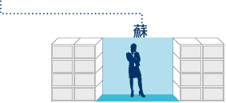
零售目标 - 基本十顾客，七人强
Retail Sales Goal - Base 10, Seven Strong
7位超连锁™店主，每人有10位优惠顾客
每位超连锁™店主每月可产生500 BV及200 IBV（个人购买及优惠顾客购买）
佣金 = 每月由BV赚取RM1,200及每两个月由IBV赚取RM1,200
1500 BV & 600 IBV
1500 BV & 600 IBV
5位优惠顾客
5位优惠顾客
500 BV & 200 IBV 点数可被放置
5位优惠顾客
5位优惠顾客
5位优惠顾客
5位优惠顾客
500 BV & 200 IBV
500 BV & 200 IBV
5位优惠顾客
5位优惠顾客
5位优惠顾客
5位优惠顾客
5位优惠顾客
5位优惠顾客
5位优惠顾客
5位优惠顾客
500 BV & 200 IBV
500 BV & 200 IBV
500 BV & 200 IBV
500 BV & 200 IBV
此投影片上BV及IBV库显示周期业绩累积

Slide 27
行动的力量
Power of Your Actions
基本业务要求 Minimum Activity
毎个超连锁™店主每月产生50 BV及10 IBV 50 BV and 10 IBV monthly per UFO
每月目标及基本十顾客 Monthly Goal & Base 10
每个超连锁™店主每月产生200 BV及20 IBV
200 BV and 20 IBV monthly per UFO
每个超连锁™店主的优惠顾客每月产生300 BV及200 IBV
300 BV and 200 IBV to Preferred Customers per UFO
购物年金及基本十顾客 Shopping Annuity & Base 10
每个超连锁™店主每月产生500 BV及200 IBV
500 BV and 200 IBV monthly per UFO
每个超连锁™店主的优惠顾客每月产生300 BV及200 IBV
300 BV and 200 IBV to Preferred Customers per UFO

Slide 28
组织达到基本业务要求
organization Satisfying the Minimum Activity Requirements
佣金 = 每个月RM2,400 (BV)及每三个月RM1,200 (IBV)
基本业务要求
每位超连锁™店主每月50 BV + 10 IBV
总额 = 每位超连锁™店主50 BV + 10 IBV
每两个周期您可由BV赚取RM1,200 - RM2,400及每三个月由IBV赚取RM1,200
50 UFO’s x 50 BV = 每月2,500 BV
加上
50 UFO’s x 10 IBV = 每月500 IBV
50 UFO’s x 50 BV = 每月2,500 BV
加上
50 UFO’s x 10 IBV
= 每月500 IBV
此投影片上BV及IBV库显示周期业绩累积

Slide 29
组织完成每月目标及基本10顾客
organization Satisfying the Monthly Goal and base 10
佣金 = 每月RM24,000 (BV)及每月RM12,000 (IBV)
每月目标 每位超连锁™店主每月200 BV + 20 IBV
基本10顾客 每位超连锁™店主的10位优惠顾客产生
300 BV + 200 IBV
总额 = 每位超连锁™店主500 BV + 220 IBV
每个周期您可由BV赚取RM6,000及每两个周期由IBV赚取RM6,000
50 UFO’s x 500 BV = 每月25,000 BV
加上
50 UFO’s x 200 IBV = 每月10,000 IBV
50 UFO’s x 500 BV = 每月25,000 BV
加上
50 UFO’s x 200 IBV = 每月10,000 IBV
此投影片上BV及IBV库显示周期业绩累积

Slide 30
组织完成购物年金及基本10顾客
organization Satisfying the Shopping Annuity™ and base 10
佣金 = 每月RM33,600 (BV)及每月 RM24,000 (IBV)
购物年金 每位超连锁™店主每月500 BV + 200 IBV
基本10顾客 每位超连锁™店主的10位优惠顾客产生
300 BV + 200 IBV
总额 = 每位超连锁™店主800 BV + 400 IBV
每个周期您可由BV赚取RM8,400及每个周期由IBV赚取RM6,000
50 UFO’s x 800 BV = 每月40,000 BV
加上
50 UFO’s x 400 IBV = 每月20,000 IBV
50 UFO’s x 800 BV = 每月40,000 BV
加上
50 UFO’s x 400 IBV = 每月20,000 IBV
此投影片上BV及IBV库显示周期业绩累积

Slide 31
基本业务要求 Minimum Activity
行动的力量
平均每月佣金RM2,400
RM2,400 average monthly commissions
每月目标及基本十顾客 Monthly Goal and Base 10
平均每月佣金RM36,000
购物年金及基本十顾客 Shopping Annuity & Base 10
平均每月佣金RM57,600
RM57,600 average monthly commissions

Slide 32
成功五要诀培训
(The Basic Five)

